Slide 1
The 2020 Census:
Ensuring a Full Count in 2020
April 8, 2020
Genesis Sanchez
Texas Regional Census Campaign Manager

Slide 2
Civic Engagement Mission Statement
The NALEO Educational Fund’s Civic Engagement department works towards full participation of Latinos in the American political process by promoting naturalization, electoral participation, and Census.
The department works at the community level, and through local, regional, and national strategic partnerships.

Slide 3
What is the Census?
The Census is a count of every person living in the United States
Includes U.S. territories
We call it: decennial, enumeration, count
As mandated by the Constitution, the U.S. Census Bureau conducts the count every 10 years
Everyone is required to participate, no matter their age, race, ethnicity, or immigration status

Slide 4
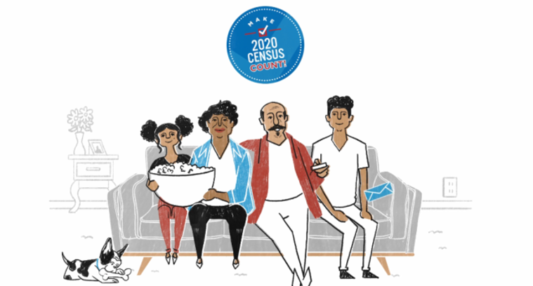
Why should we care about a fair and accurate Census?
$60 billion in resources
is allocated to Texas
communities annually
Determines where
essential services should
be built, like schools, hospitals, and roads
It funds key federal programs that our families depend on (ex: Head Start, CHIP, Medicaid, and WIC)
Determines political representation. In 2020, Texas has the opportunity to gain 2-3 congressional seats and redraw its electoral districts

Slide 5
2020 Census & COVID-19
COVID-19 is showing us the importance of having reliable and accurate Census data
First responders
Hospitals & community health centers
Grocery stores
Internet access
School resources
Food banks
Message: “As we face this public health crisis, participating in the Census now helps secure future funding for our communities.”

Slide 6
Top 12 Census-guided federal programs
Program | Amount (in billions)
Medical Assistance Program (Medicaid) | $368.4
Medicare Part B -- Medicare Supplementary Medical Insurance | $313.7
Medicare Part A -- Medicare Hospital Insurance | $296.5
Medicare Part D -- Prescription Drug Coverage | $100.0
Supplemental Nutrition Assistance Program | $67.8
Highway Planning and Construction | $42.1
7(a) Loan Guarantees (Small Business Administration loan program) | $24.0
Very Low to Moderate Income Housing Loans (Section 502) | $20.3
Section 8 Housing Choice Vouchers | $16.7
State Children's Health Insurance Program | $16.0
Title I Grants to LEAs | $15.5
Special Education Grants | $12.0
Source: Andrew Reamer, Counting for Dollars 2020: The Role of Decennial Census in the Geographic Distribution of Federal Funds, George Washington University, November 2019 (Based on FY 2017 / 316 Program analysis)

Slide 7
The count has improved over time but certain populations have historically been missed, including:
African Americans, Latinos and American Indians
Low-income households
Immigrants and individuals with low English-language proficiency
Renters
Residents who live in non-traditional housing
Rural residents
Highly mobile residents, such as farmworkers
Very young children aged 0-4
Communities affected by natural disasters
Individuals with disabilities
Elderly
Approximately 25% of Texas’ current population
(over 6 million people) live in “hard to count” areas
1% undercount in TX ~ $300m federal funds annually

Slide 8
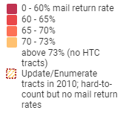
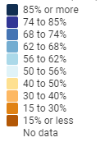
Left: Hardest to count tracts in Texas
Right: Current (4/7/20) response rates
As of 4/7/20, Texas is currently at a 41.1% response rate, compared to 45.7% national response rates.

Slide 9
Very Young Children are Most Likely to be Excluded from the Census Count
In 2010, we had a net undercount of 1 million very young children.
Many times, caretakers don’t know they should include their babies! Remind families to include their babies and young children.
Source: Child Trends Hispanic Institute and NALEO Educational Fund, The Invisible Ones: How Latino Children are Left out of our Nation’s Census Count.

Slide 10
Key Census Dates
January 2020:
The first enumeration begins in remote areas of Alaska, before the spring thaw.
April 1, 2020:
National Census Day
March – April 2020:
Self Response phase of Census 2020
(internet, mail, and phone; four waves of staggered mail).
Mid-May – Aug 2020:
Primary non-response follow-up operation (to households that did not self-respond).
December 31, 2020:
Census Bureau delivers final apportionment count to White House

Slide 11
How households will be invited to self-respond in 2020:
Online
my2020census.gov
Phone
English: (844) 330-2020
Spanish: (844) 468-2020
Paper
Message: Self-responding to the Census is the easiest way to make sure you are counted amid the COVID-19 situation. Self-response is quick, easy, and can be done online, by phone or mail.
Notes:
Households will be able to self-respond in 3 ways: online, by phone, or by mail
After April 30th, enumerators will go out to count households in person. We’ll be encouraging our patients and their families to self-respond before that date.

Slide 12
How the public will be invited to self-respond in 2020:
Between March 12 – 20:
Households receive an invitation to respond online to the 2020 Census (some households will receive paper questionnaires).
If you have not responded yet:
Between March 16 – 24:
A reminder letter is sent.
If you have not responded yet:
Between March 26 – April 3:
A reminder postcard is sent.
If you have not responded yet:
Between April 8 – 16:
A reminder letter and paper questionnaire is sent.
If you have not responded yet:
Between April 20 – 27:
A final reminder postcard is sent before the Census Bureau follows up in person.
Source: U.S. Census Bureau, "How Everyone will be Invited to Respond"

Slide 13
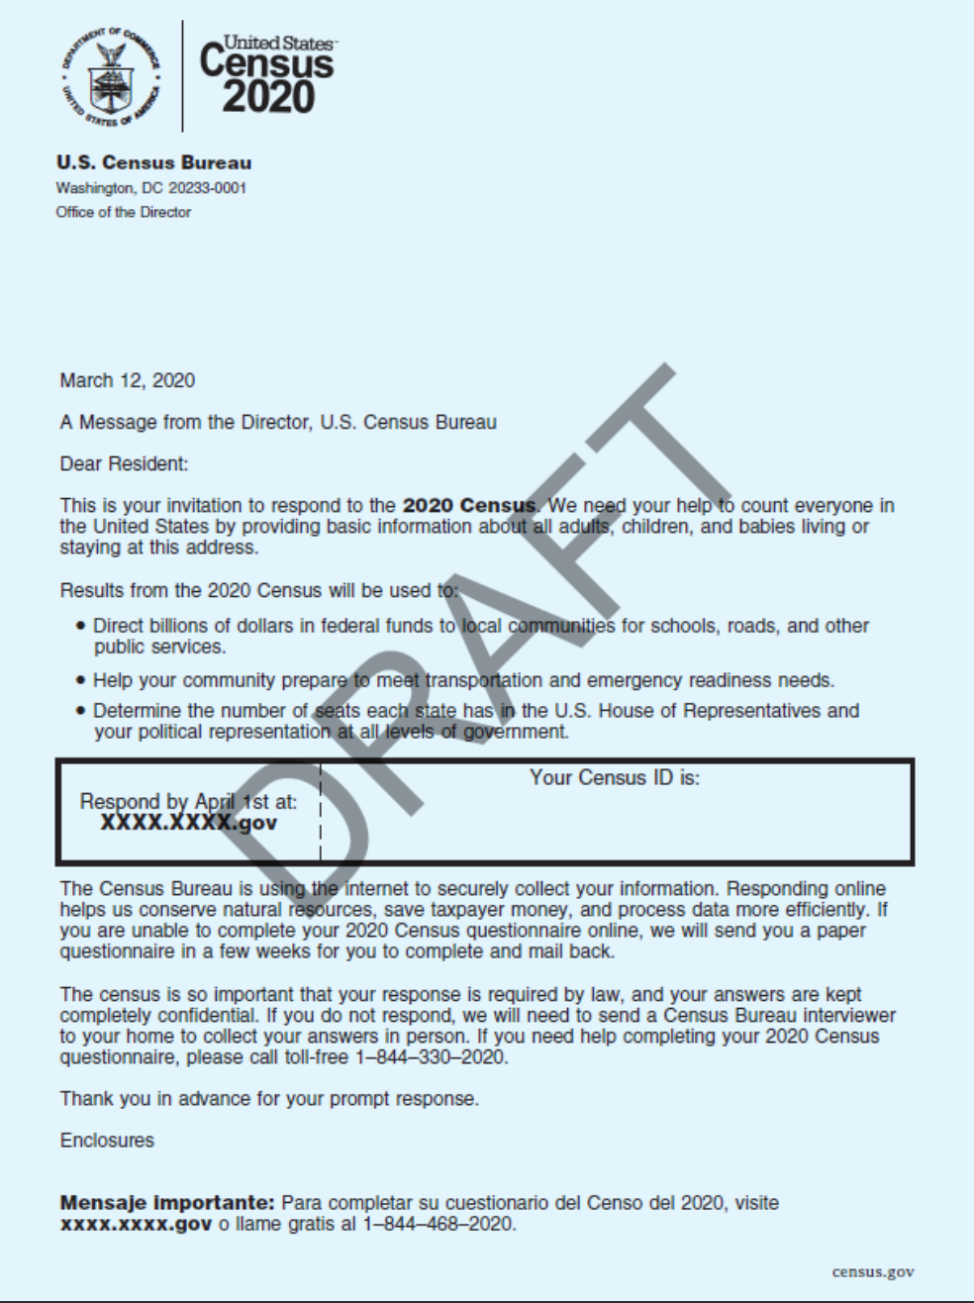
Sample Invitation Letter:
Important:
Letter will be made out to “Dear Resident” and not to a specific person

Slide 14
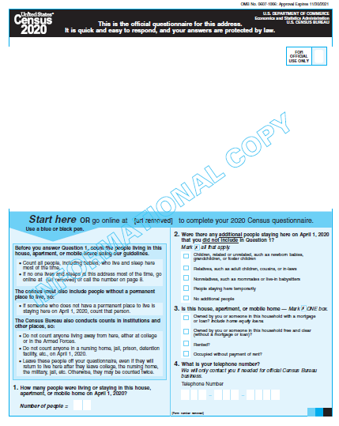
The 2020 Census Questionnaire will ask:
Number of people living or staying in the house, apartment, or mobile home on April 1, 2020
Whether the residence is a house, apartment, or mobile home
Telephone number (if needed for Census Bureau follow-up)
Sex
Age
Date of Birth
Hispanic Origin
Race
Relationships of persons in the household, including opposite and same sex spouses and unmarried partners
HagaseContar.org | #HazmeContar
Notes:
Emphasize simplicity of questions & confidentiality
Responses are protected by law and cannot be used against individuals

Slide 15
The 2020 Census Questionnaire WILL NOT ASK:
Citizenship Status
Immigration Status
Social Security Number
Permits or licensing of any converted units on property
Use of public benefits
Criminal background or convictions
Bank account or payment information
Employment, income or wealth information
HagaseContar.org | #HazmeContar

Slide 16
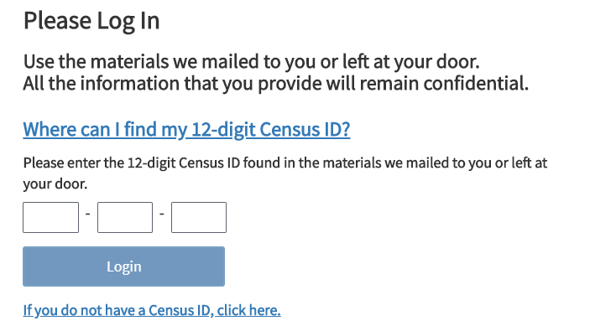
What happens if you don’t have your Census ID? Non-ID Response
USE THIS SELF-RESPONSE METHOD IF:
Your household did not receive any census materials by mail or in person.
You “lost” the materials your household received.
Your household responded but left you off the form.
IMPORTANT: People cannot get a paper form by calling the Census Bureau!

Slide 17
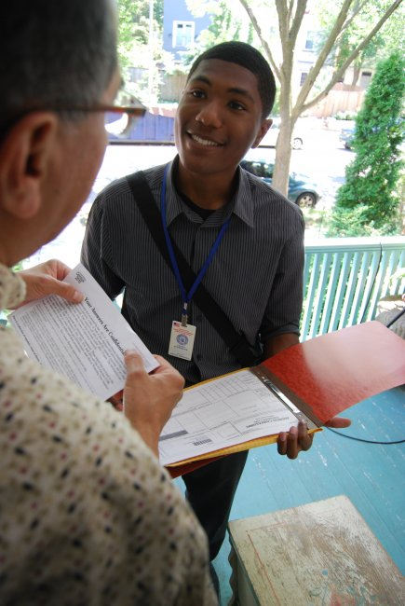
Non-Response Followup (NRFU) Phase
May 28 – Aug 14*
If Census takers do visit your home:
They will never ask to enter the home.
They will identify themselves and wear a U.S. Census
Bureau badge.
They will only ask questions that are on the questionnaire
– this means they will not ask about citizenship or
immigration status, or financial information.
They will never ask for or request additional documentation.
Households can continue to self-respond through
August 14.

Slide 18
Let’s talk about Title 13
Under Title 13 of U.S. Code:
Census data can only be used for statistical purposes; personal information cannot be used against respondents in court or by a government agency.
Personal census information cannot be disclosed for 72 years (includes names, addresses, Social Security numbers and telephone numbers).
Census Bureau staff who have access to personal information are sworn for life to protect confidentiality.
Sworn staff are subject to a $250,000 fine and/or up to five years in prison for wrongful disclosure of information.
Policymakers and advocates are working to ensure full Administration compliance with these critical protections.

Slide 19
How can you support the 2020 Census?
Continue to encourage your networks and communities to self-respond!
“Filling out the Census is fast, easy and your information is confidential!”
Our communities are looking for a trusted messenger to give the “okay” to the census.
Pivot from in-person to online activities:
Text bank, phone bank, and leverage social media
Pivot from big events to essential locations:
Partner with essential locations to distribute materials
Grocery stores, food banks, diaper banks, gas stations, schools, restaurant take-out, clinics, hospitals, etc.
Stay in the loop! Send me an email (gsanchez@naleo.org) to get weekly updates.

Slide 20
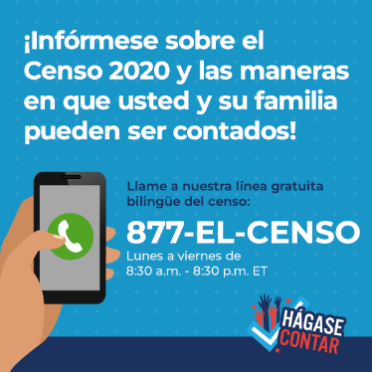
Bilingual Census Information Hotline
877-EL-CENSO
(877-352-3676)
Monday – Friday: 8:30 a.m. – 8:30 p.m. CT

Slide 21
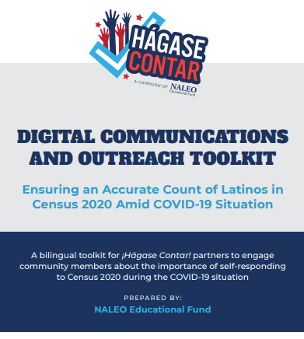
www.hagasecontar.org/resources

Slide 22
Thank you.
Genesis Sanchez
Texas Regional Census Campaign Manager gsanchez@naleo.org
Twitter: @NALEO | #HagaseContar www.hagasecontar.org
www.naleo.org

