Slide 1
American Organization for Immigrants
702 Donaldson Avenue, Suite 209,
San Antonio, Tx. 78201
We are a non profit organization helping immigrants in San Antonio

Slide 2
Family Immigration
Goal: Preserving family unity
Assisting with family based petitions
Goal: Citizenship
Assisting in application process
ESL and Civics courses
Goal: Low Cost Immigration Services
Asylum, DACA, Employment Authorization and Others (U Visa)

Slide 3
What We Do
In a broader sense we offer help and information about the immigration process and paths to lawful permanent residence and citizenship.
We provide to low income clients orientation on how to adapt to the cultural changes and responsibilities to live in our country, the importance of learning English and how to prepare to find meaningful employment.

Slide 4
What We Do
Our vision is to ensure our clients integration as legal permanent residents and citizens in the United States.
Office: 10am – 3pm, Monday – Thursday, Evenings and Saturdays with appointments
Email: amerorgimg@gmail.com
www.amerorg.com
210 250 0762 / 210 454 2164

Slide 5
Our Goals For This Year:
Four Citizenship Workshops for
Lawful Permanent Residents
Four Tutorial Classes for the
Citizenship Interviews
Expansion of Our Capability to Assist
Asylum Cases
Application
Immigration Court Appearances

Slide 6
Some Numbers

Slide 7
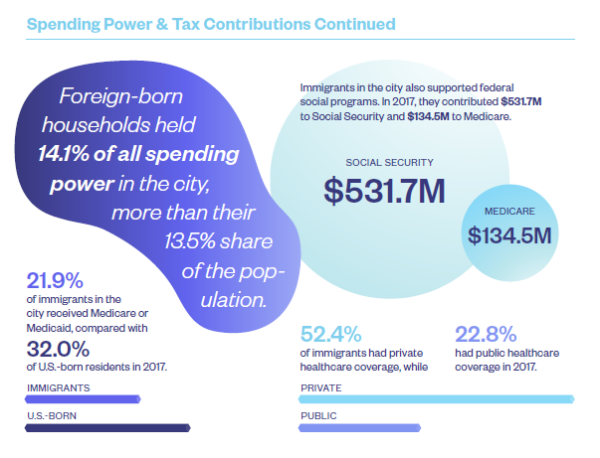
Some Numbers

Slide 8
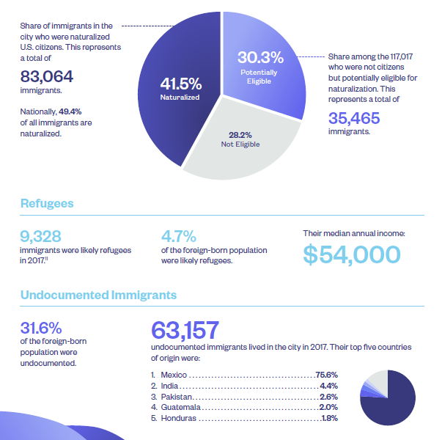
Some Numbers

Slide 9
Northern Triangle
San Antonio is closer
to Guatemala City than to Washington, D.C.
Notes:
Sr. Denise

Slide 10
Women in the Northern Triangle
50% of murders of women in Guatemala were gang related
98% of murders are not prosecuted in Guatemala
Of the top 5 countries for femicide (female murder), 3 are in the Northern Triangle:
#1 El Salvador
#2 Honduras
#4 Guatemala
Notes:
Sr. Denise

Slide 11
Steps in the Journey
Travel north through Mexico
Surrender at border and ask for help
Held at border and put in “ice box” and “dog pound”
Placed in family detention during processing.
Notes:
Sr. Denise insert story. Talk about the ice box ad dog kennel.

Slide 12
Routes to the U.S.

Slide 13
La Bestia

Slide 15
Notes:
Ursula is the colloquial name for the Central Processing Center, the largest U.S. Customs and Border Protection detention center for undocumented immigrants. The facility is a retrofitted warehouse that can hold more than 1,000 people.^{[1]} It was opened in 2014 on W. Ursula Avenue in McAllen, Texas. In June 2018, it gained notoriety for the practice of keeping children in large cages made of chain-link fencing.[

Slide 16
Family Detention
Family Detention for parent and child(ren)
Dilley (TX), Karnes (TX) and Berks (PA)
Trump administration has budgeted expansion of family detention
Facilities operated by GEO and CoreCivic, private for-profit prison companies
Bottom line: We do not need to be protected from asylum seeking families, we need to be protecting them.

Slide 17
What happens in Family Detention?
Parent and child(ren) held in a prison like facility
Inadequate medical care
Await credible fear interviews, but no guarantee of representation
If they fail the credible fear interview, they probably will be deported
May be held for several weeks

Slide 19
What is the San Antonio Interfaith Welcome Coalition?
Came together in the summer of 2014 in response to overwhelming need of unaccompanied children coming from Central America
IWC is a broad network of faith communities and community organizations
IWC volunteers provide guest housing to individuals coming to San Antonio to provide services to asylum seekers in detention.
Currently the IWC has a bus station/backpack ministry; an airport/backpack ministry; overnight hospitality; overnight shelter and volunteer accompaniment to ICE check in and immigration court hearings.
Advocacy/Education on behalf of asylum seekers, refugees and at-risk immigrants

Slide 22
Bus Station Backpack List
Toiletries placed in a quart size Ziploc bag
2 toothbrushes 1 travel size toothpaste 1 package of hand wipes 2 packages travel size Kleenex 2-3 hair bands or scrunches
Optional but highly recommended Small pocket size English-Spanish Dictionary Small stuffed animals
Snacks placed in a gallon Ziploc bag 3 packages of fruit snacks 3-4 granola bars 2-3 packages of animal crackers 2-3 packages of Cheezits 2-3 packages of salt snacks (peanut butter crackers, cheese crackers)
Important Needed Items
1 bottle of water and one water bottle
1 Small blanket (4×6)
Other Useful Items
2 pens 1 small note pad Coloring book and crayons

Slide 23
Immigration Policy Changes
Border Arrivals Decreased
Backpacks 2019 2020
Bus Station 18,447 412
Airport 7,130 341
Increased Focus On Advocacy
Support for Border Partners
DONATION:
http://interfaithwelcomecoalition.org/donate/
Interfaith Welcome Coalition,
C/O University Presbyterian Church,
300 Bushnell, San Antonio, Texas 78212

Slide 24
DHS Policy Protocols
Migration Protection Protocol (MPP) /
Remain in Mexico
Refinements of the MPP
Prompt Asylum Claim Review (PACR)
Humanitarian Asylum Review Process (HARP)
Safe Third Country Rule

Slide 25
Thank you for your attention
Questions

